Slide 1
Testing
Towards THE bug free program

Slide 2
Edsger W. Dijkstra
Program testing can be used to show the presence of bug, but never to show their absence!!

Slide 3
I don’t make mistakes!!
http://www.dailymail.co.uk/sciencetech/article-2531601/Windows-error-messages-let-NSA-spy-people-Crash-reports-neat-way-gaining-access-machines-claims-report.html

Slide 4
Why create a test suite?
Obviously you have to test your code—right?
You can do ad hoc testing (running whatever tests occur to you at the moment), or
You can build a test suite (a thorough set of tests that can be run at any time)
Disadvantages of a test suite
It’s a lot of extra programming
True, but use of a good test framework can help quite a bit
You don’t have time to do all that extra work
False! Experiments repeatedly show that test suites reduce debugging time more than the amount spent building the test suite
Advantages of a test suite
Reduces total number of bugs in delivered code
Makes code much more maintainable and refactorable

Slide 5
Software development
enclosing the real world
J-Unit
Test developing
Multiple tools
Maven
Dependency management

Slide 6
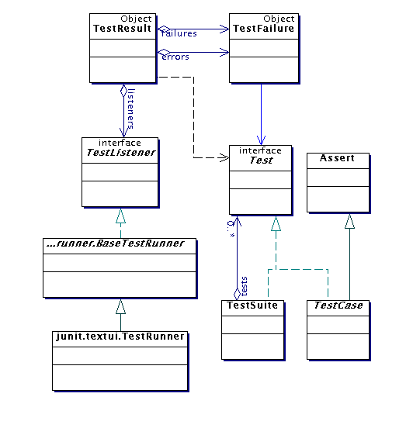
Architectural overview
JUnit test framework is a package of classes that lets you write tests for each method, then easily run those tests
TestRunner runs tests and reports TestResults
You test your class by extending abstract class TestCase
To write test cases, you need to know and understand the Assert class

Slide 7
Writing a TestCase
To start using JUnit, create a subclass of TestCase, to which you add test methods
Here’s a skeletal test class:
import org.junit.Test;
…
@Test
public class TestBowl {
} //Test my class Bowl

Slide 8
Writing methods in TestCase
Pattern follows programming by contract paradigm:
Set up preconditions
Exercise functionality being tested
Check postconditions
Example:
public void testEmptyList() {
Bowl emptyBowl = new Bowl();
assertEquals(“Size of an empty list should be zero.”,
0, emptyList.size());
assertTrue(“An empty bowl should report empty.”, emptyBowl.isEmpty());
}
Things to notice:
Specific method signature – public void testWhatever()
Allows them to be found and collected automatically by JUnit
Coding follows pattern
Notice the assert-type calls…

Slide 9
Assert methods
assertTrue(String message, Boolean test)
assertFalse(String message, Boolean test)
assertNull(String message, Object object)
assertNotNull(String message, Object object)
assertEquals(String message, Object expected, Object actual) (uses equals method)
assertSame(String message, Object expected, Object actual) (uses == operator)
assertNotSame(String message, Object expected, Object actual)

Slide 10
Ok so dependencies
Project Dependency
Libraries needed for build and runtime.
Project Reports
Junit reports
Javadoc reports
Checkstyle reports, ….etc

Slide 11
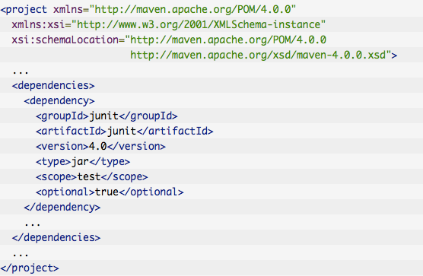
Take a look to pom.xml

